Slide 1


SAP UI5 & FIORI with OData TRAINING
Anubhav Oberoy
Day – 27

Slide 2

Agenda – Day 27
Overview page App
Create App from external Service
Add bullet Chart inside table
Working with In-app Extensibility

Slide 3
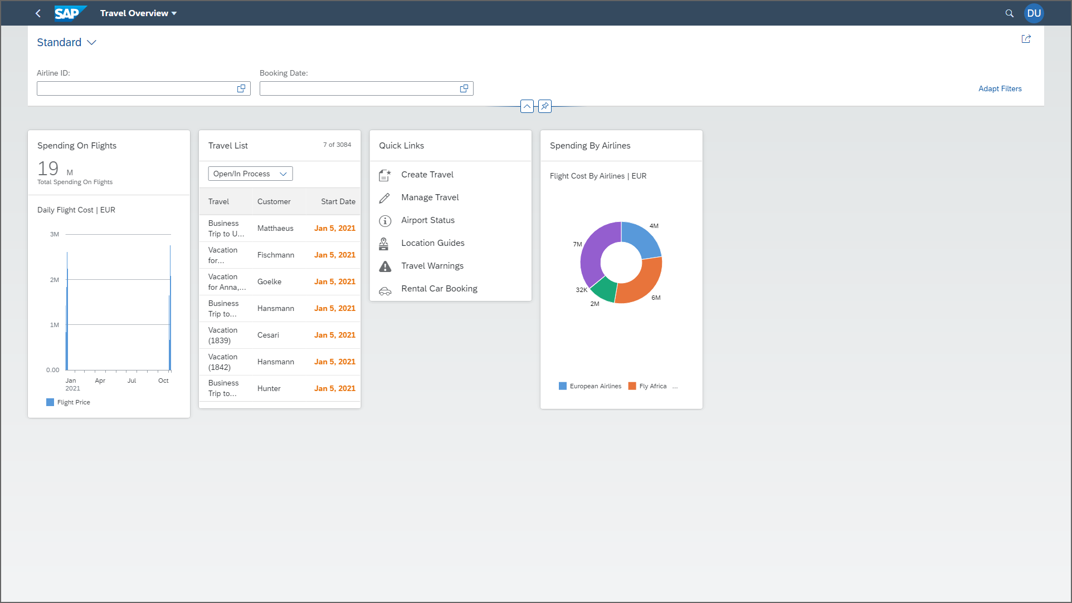
Building OVP – Overview page

Slide 4
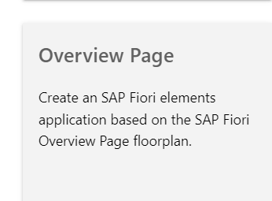
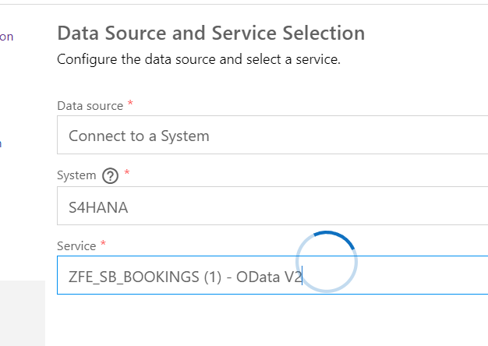
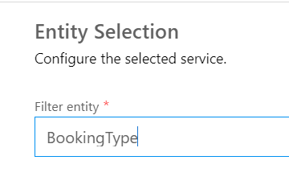
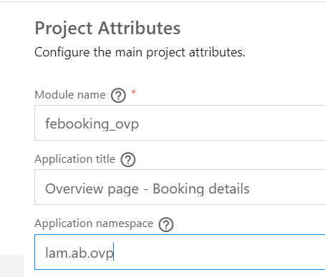

Slide 5
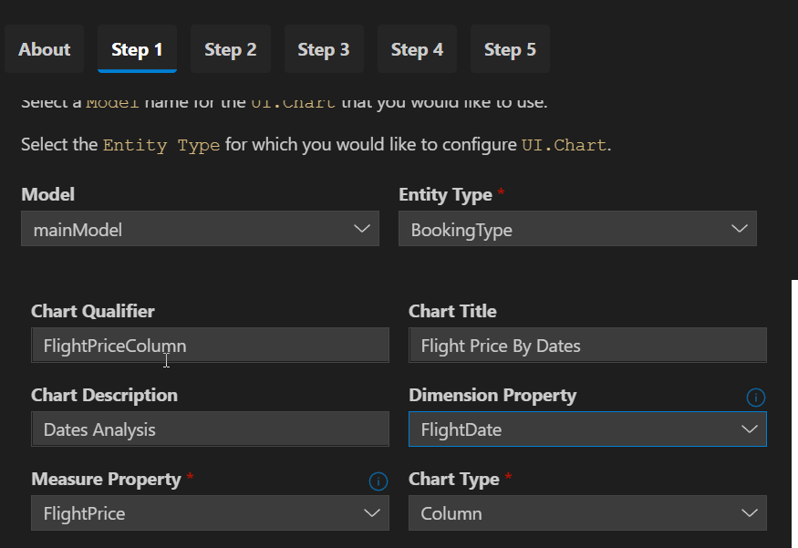
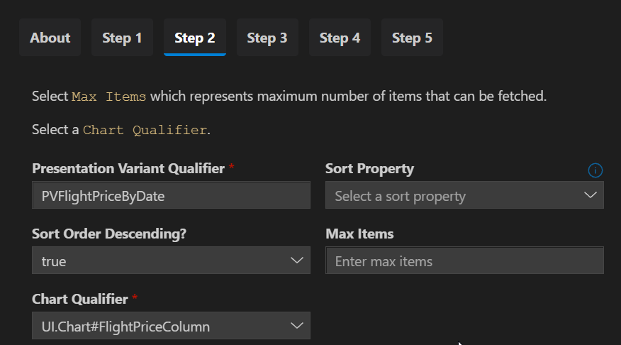
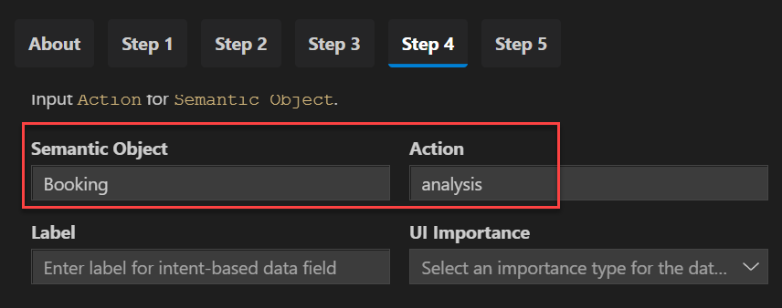
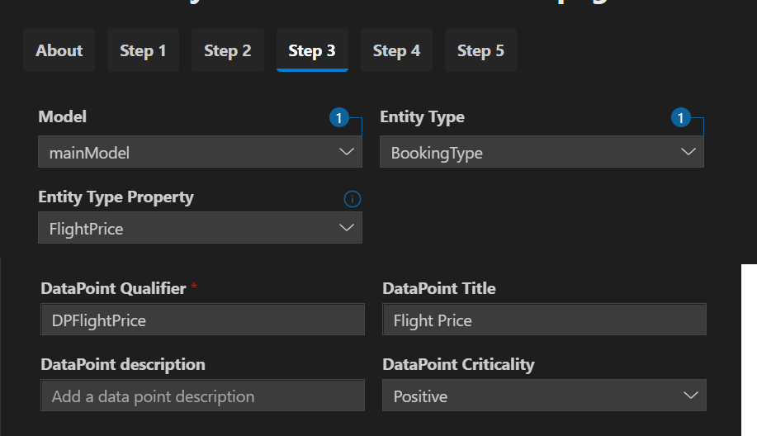

Slide 6
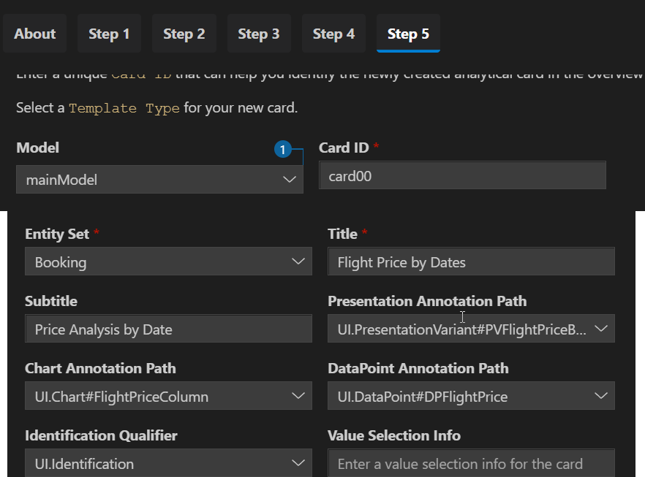

Slide 7
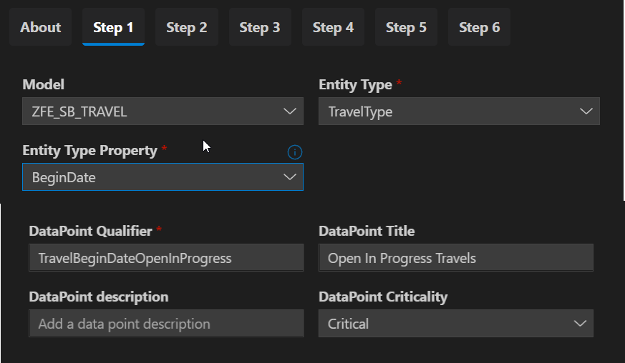
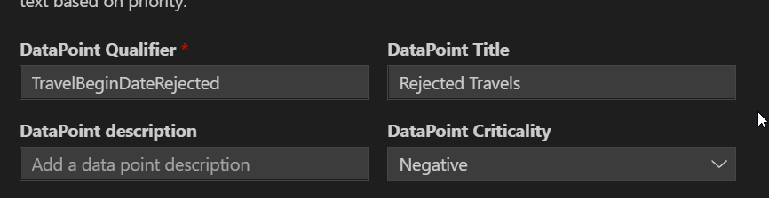

Slide 8
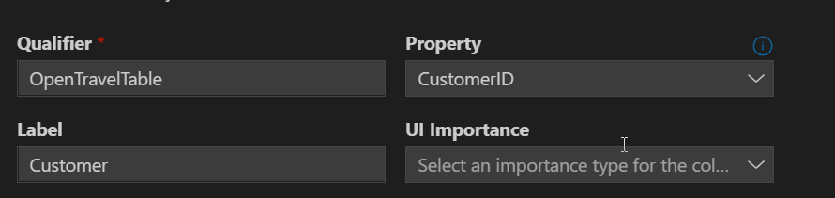
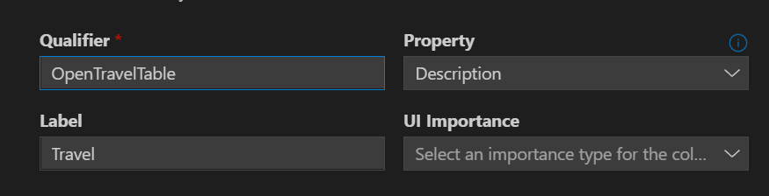
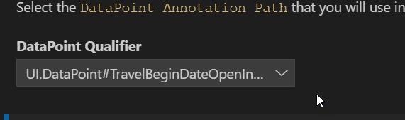

Slide 13

End of Day 27

Slide 14
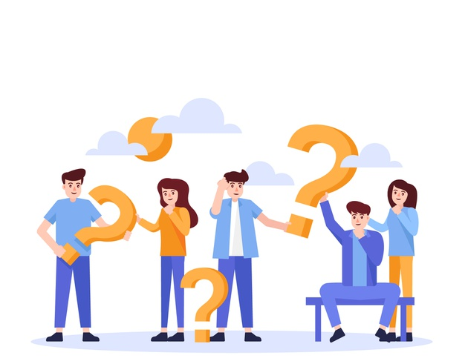
Questions

Slide 15

Anubhav Oberoy

Slide 16


We’re committed to empower you to be
Most Desirable Resource
through powerful training solutions.
We build the workforce of the future.
270+
Corporate Clients
30,000+
Learners Trained
27000+
Learners Placed
FREE WEBINARS
Sign up for free webinars with industry experts every fortnight!
Enroll Now!
Contact us today!
https://anubhavtrainings.com/

Slide 17




More from AnubhavTrainings.com

Slide 18
Title
Content

